Slide 1
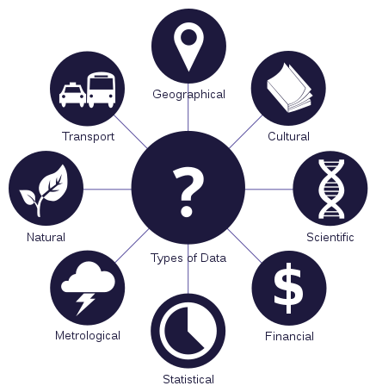

Data Management: Make sense of the complexity around data storage, description, re-use and archiving.
Shiobhan Smith, Research Support Unit

Slide 2
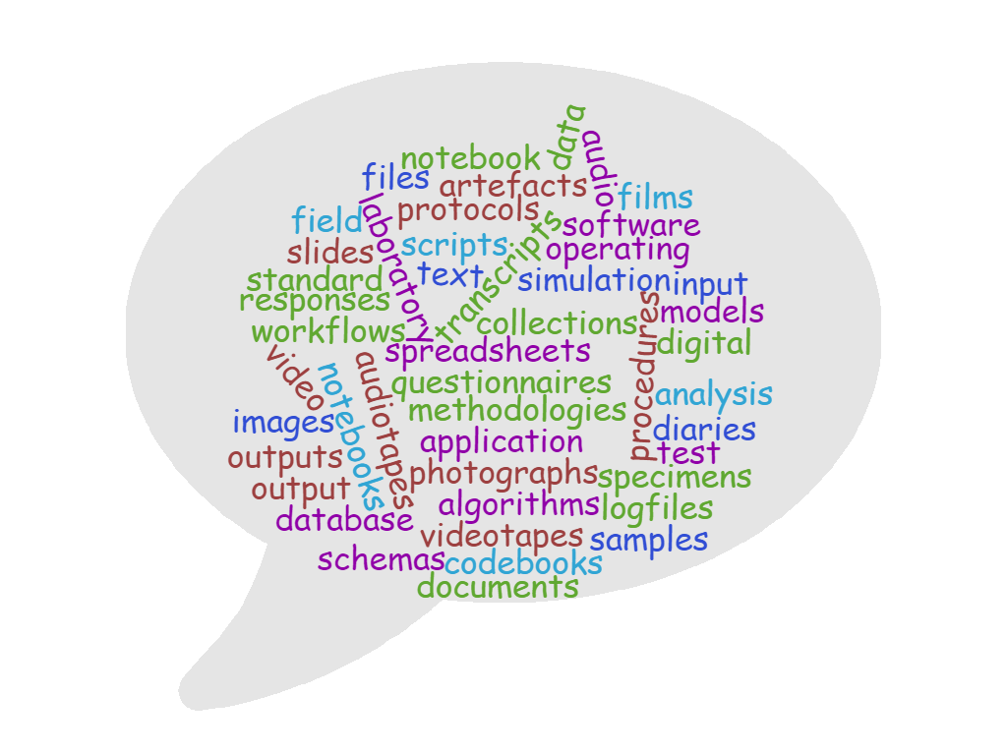
What is your research data?
Notes:
In your discipline what is your research data
Talk to your neighbour then share

Slide 3

What does Research Data Management mean (or look like) to you?

Slide 4
What does Research Data Management mean (or look like) to Researchers, Librarians, Data Curators/Stewards, Publishers, Funders, Government Agencies…?
Metadata
Quality Assurance
Restricted Access
Secure Storage
Chain of Custody
Risk Management
File Inventory
Persistent Identifier
Software Registry
Versioning
Succession Planning
Embargo
Full-Text Indexing
Contact Information
Discovery Services
Documentation
Data Citation
Use Analytics
Migration
File Validation
Rights Management
Code Review
Contextualise a Data Set
File Format Transformations
File Audit
Peer-Review
Terms of Use
Technology Monitoring and Refresh
Metadata Brokerage
Selection
Deposit Agreement
Indexing
Repository Certification
Cease Data Curation
Data Cleaning
Data Restructuring
Data Visualisation
Arrangement and Description
Authentication
Conversion (Analog)
Curation Log
Emulation
Deidentification
Interoperability
Transcoding

Slide 5
What about research domain specific information?
What we will cover:
Let’s make Research Data Management a little less scary
General best-practice principles of management, storage and sharing of research data
Practical tips for improving your data management practices that you can implement immediately
How to be prepared for university, employer, funder and/or publisher data requirements
Opportunities to reflect and share how this might apply to the DBA and your research data specifically

Slide 6
Gain: Clarity and Efficiency.
Data Management: Level 1
Be organised
Clear file structures
Clear file naming system
Version control
Automated options?
Regularly back up your data and documents
External hard drive OR cloud storage

Slide 7
Gain: Risk Management.
Data Management: Level 2
Data Management Plan
Agreed plan on the collection, description, short and long term storage, and potential sharing of data
Ensure ethics and consent align with future goals
Do you have funder obligations?
What does your publisher of choice require?
Do you have commercialisation plans?
Obligations to the University (e.g. IP) or another organisation (e.g. using data from a third party)?
What data to keep long term?
Be clear about who owns your data and what is expected!
Use University supported systems for back up and moving of data where applicable:
Size
Data sensitivity/confidentiality
Data sovereignty
Notes:
https://www.otago.ac.nz/library/dmp/index.html
Designed for all disciplines. No compulsory fields deliberate. Output to txt file… why (relates to level 3)?
Related policies:
https://www.otago.ac.nz/administration/policies/otago003211.html
https://www.otago.ac.nz/administration/policies/otago003228.html
DMP exercise
-Did the DMP help you think more holistically about your data? How?
-What questions were the hardest to answer? Why?

Slide 8
Gain: Data that lives beyond the life of one specific research project.
Data Management: Level 3
Save your data in formats that allow the future you, or another future researcher, to open them
If you are working with data as part of a bigger research team, clarify your long term access and use to that data
Document everything
Metadata is the key first step
Plan for long-term storage
Level of security and terms of use
Notes:
A metadata standard or schema is a set group of elements that have been standardized for a particular field. Some scientific disciplines already have established metadata standards for data sets. Additionally, some data repositories also have their own standards. One of the standards listed below might be exactly what you need to document your data. If there is not a standard already in place for your data, there are several general purpose schemas that you can adapt to your needs.
DDI example:
http://www.ddialliance.org/training/getting-started/data-catalog
Note – controlled vocab – exact meanings for each field
API queries easier – knows exactly what is what and information can be exchanged easier
Tools to help

Slide 9
Basic Metadata
These are some ISO suggested minimal metadata elements to use when you are documenting your data:
Title
Creator (Principal Investigators)
Date Created (also versions)
Format (and software required)
Subject
Unique Identifier
Description of the specific data resource
Coverage of the data (spatial or temporal)
Publishing Organization
Type of Resource
Rights
Funding or Grant
Data Management: Level 3
Notes:
A metadata standard or schema is a set group of elements that have been standardized for a particular field. Some scientific disciplines already have established metadata standards for data sets. Additionally, some data repositories also have their own standards. One of the standards listed below might be exactly what you need to document your data. If there is not a standard already in place for your data, there are several general purpose schemas that you can adapt to your needs.
DDI example:
http://www.ddialliance.org/training/getting-started/data-catalog
Note – controlled vocab – exact meanings for each field
API queries easier – knows exactly what is what and information can be exchanged easier
Tools to help

Slide 10
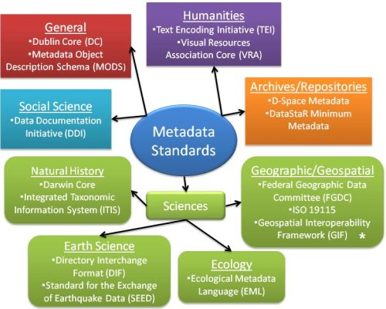
Notes:
A metadata standard or schema is a set group of elements that have been standardized for a particular field. Some scientific disciplines already have established metadata standards for data sets. Additionally, some data repositories also have their own standards. One of the standards listed below might be exactly what you need to document your data. If there is not a standard already in place for your data, there are several general purpose schemas that you can adapt to your needs.
DDI example:
http://www.ddialliance.org/training/getting-started/data-catalog
Note – controlled vocab – exact meanings for each field
API queries easier – knows exactly what is what and information can be exchanged easier
Tools to help

Slide 11
Gain: Data that lives beyond the life of one specific research project.
Data Management: Level 3
Save your data in formats that allow the future you, or another future researcher, to open them
If you are working with data as part of a bigger research team, clarify your long term access and use to that data
Document everything
Metadata is the key first step
Plan for long-term storage
Level of security and terms of use
Notes:
A metadata standard or schema is a set group of elements that have been standardized for a particular field. Some scientific disciplines already have established metadata standards for data sets. Additionally, some data repositories also have their own standards. One of the standards listed below might be exactly what you need to document your data. If there is not a standard already in place for your data, there are several general purpose schemas that you can adapt to your needs.
DDI example:
http://www.ddialliance.org/training/getting-started/data-catalog
Note – controlled vocab – exact meanings for each field
API queries easier – knows exactly what is what and information can be exchanged easier
Tools to help

Slide 12

Notes:
https://youtu.be/66oNv_DJuPc

Slide 13
Gain: Visibility and Impact.
Data Management: Level 4
Data as a first class research output?
Data Repositories
Domain/discipline Specific vs General vs Institutional
Persistent Identifier for your data
Citation Impact
Data Journals?
Creative commons licence?
Open Science/Research movement and the reproducibility crisis
Where do you think your discipline stands on reproducibility?
Notes:
Acknowledge that two common ways data is shared is through supplementary materials and/or through departmental, project or personal webpage. – There are some cons however – may be costly, unlikely to offer a data repository’s functionality or long term solution. Least likely to make your data collection visible to new users and contacts, or to sustain long term access to your data collection.
https://figshare.com/articles/Perceptions_of_competence_strength_and_age_influence_voters_to_select_leaders_with_lower_pitched_voices/1478783
https://www.wiki.ed.ac.uk/display/datashare/Sources+of+dataset+peer+review
https://creativecommons.org/share-your-work/licensing-types-examples/

Slide 14
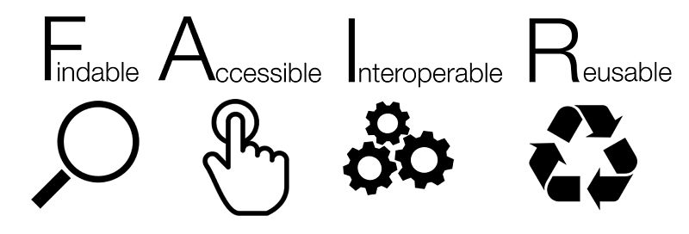
Go F.A.I.R.
Data Management: Pro Level

Slide 15
Findable
This includes assigning a persistent identifier (like a DOI or Handle), having rich metadata to describe the data and making sure it is findable through disciplinary discovery portals (local and international).
Accessible
This may include making the data open using a standardised protocol. However the data does not necessarily have to be open. There are sometimes good reasons why data cannot be made open, for example privacy concerns, national security or commercial interests. If it is not open there should be clarity and transparency around the conditions governing access and reuse.
Interoperable
To be interoperable the data will need to use community agreed formats, language and vocabularies. The metadata will also need to use a community agreed standards and vocabularies, and contain links to related information using identifiers.
Reusable
Reusable data should maintain its initial richness. For example, it should not be diminished for the purpose of explaining the findings in one particular publication. It needs a clear machine readable licence and provenance information on how the data was formed. It should also have discipline-specific data and metadata standards to give it rich contextual information that will allow for reuse.
From: https://www.ands.org.au/working-with-data/fairdata

Slide 16
Go F.A.I.R.
Data Management: Pro Level

Slide 17
Key Takeaways
Plan early…
Keep updating your plan throughout the research/data lifecycle
Metadata counts: be as sophisticated as you have to be and as simple as you can be
Be mindful of metadata standards in your discipline and be consistent in applying them to your datasets
Know what funders, publishers, institutions, employers etc. require in terms of DMPs, metadata, data sharing, protecting IP etc.
If sharing your data and wanting to know track use by other researchers, persistent identifiers are your friends
BACK IT UP!!
BACK IT UP!!!

